Slide 1
T R A I L E R
https://www.youtube.com/watch?v=icQ9r7IRp1s&feature=youtu.be
Notes:
Hello everyone! I have the pleasure to present you the first online multiplayer quantum game: QUANTUM DUEL!!

Slide 2
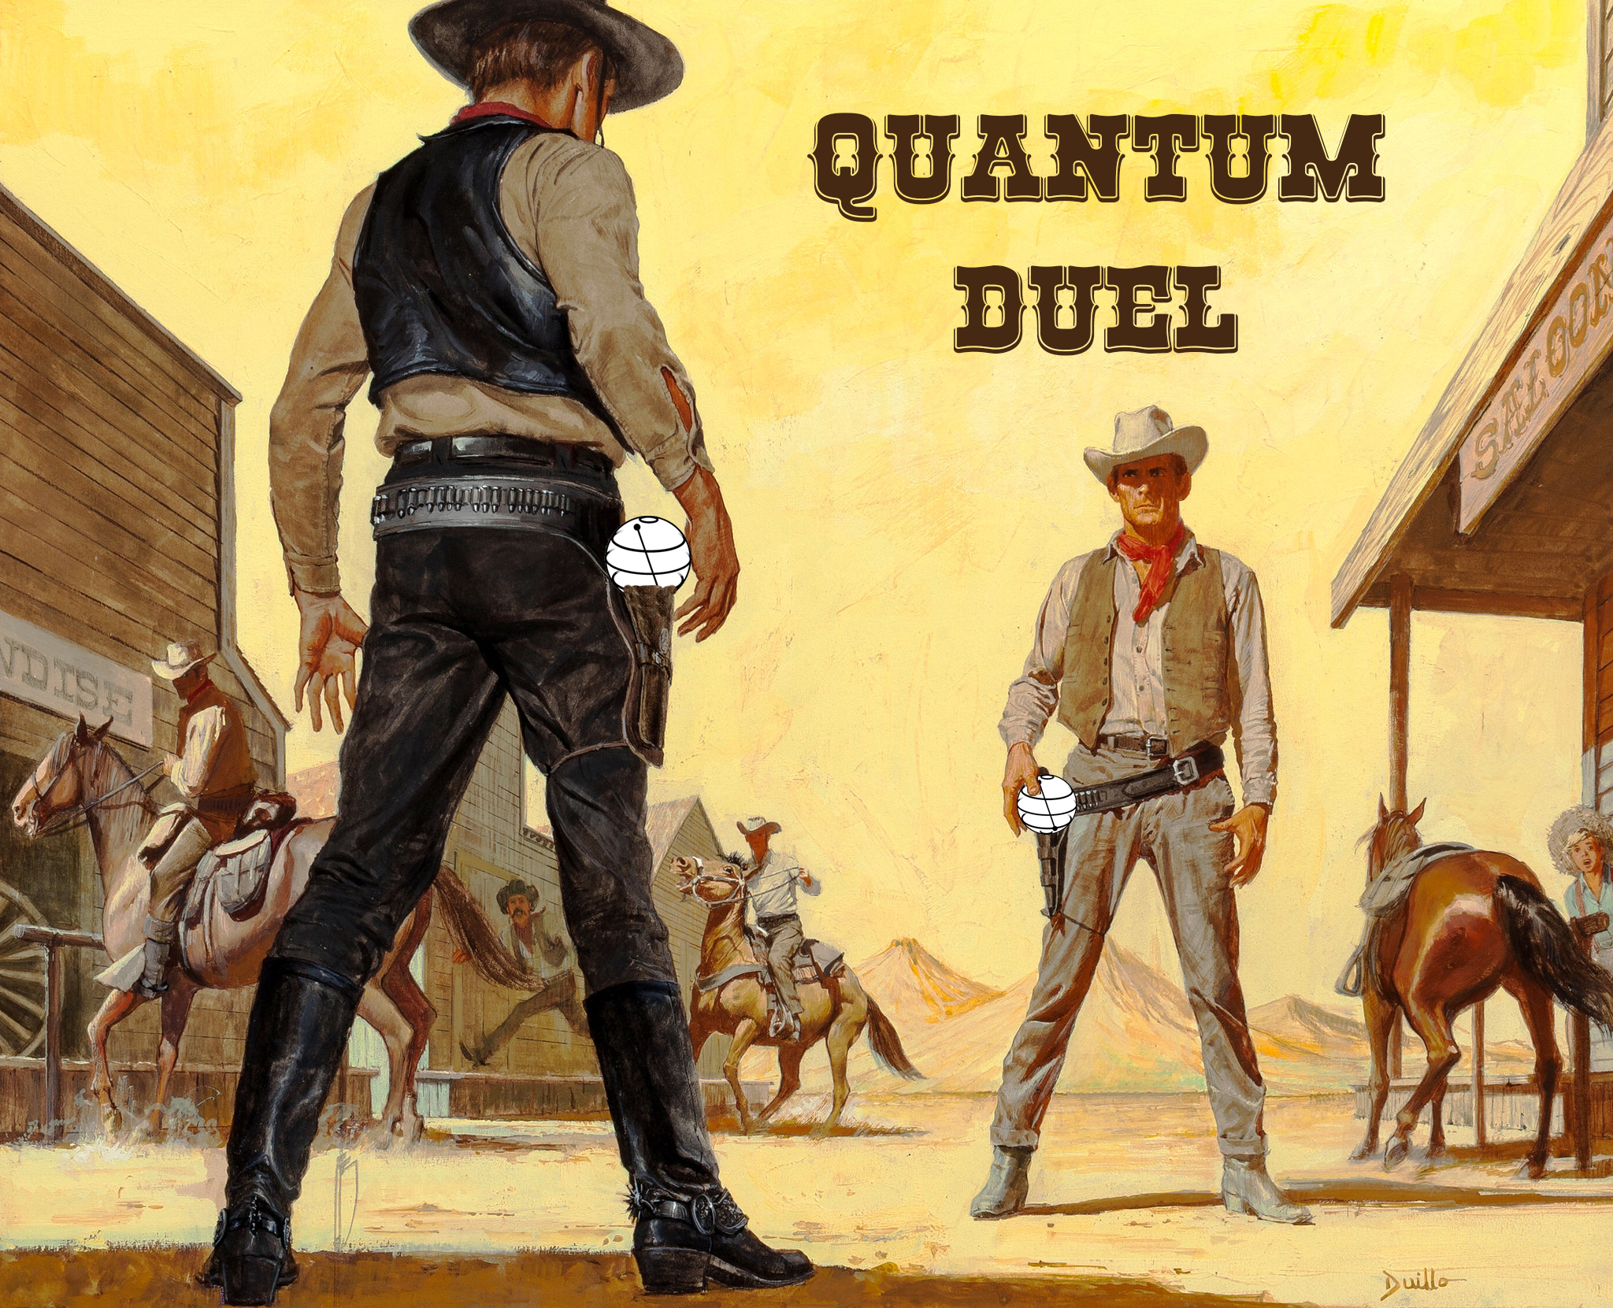
Notes:
The game is a 2-player game in which each player is given the same randomly choosen initial and final state. The first one to form a correct circuit wins and becomes the fastest draw in the Quantum West. Let’s see real gameplay!

Slide 3
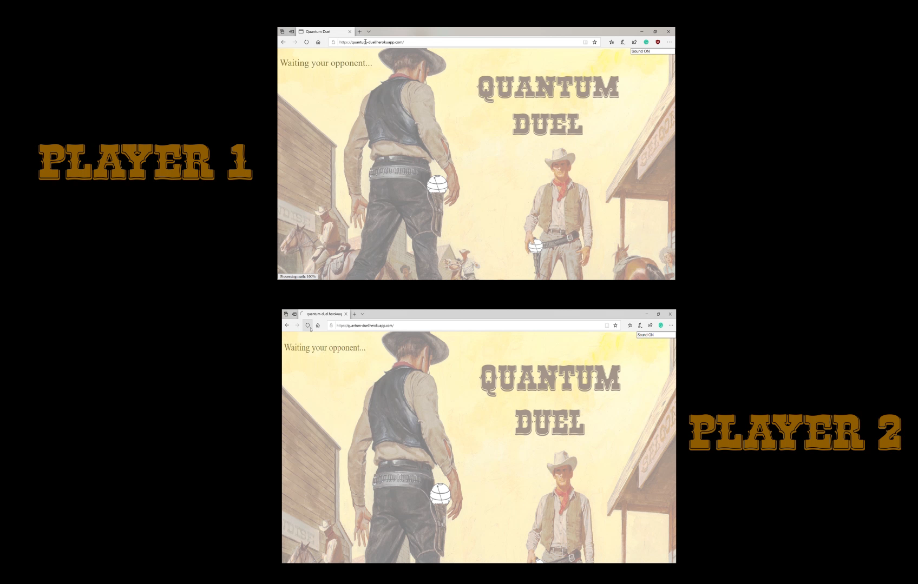
G A M E P L A Y
Notes:
As we see in the screen we have two players that start the game. When both ar connected the game starts. Here we see how the player one is getting stuck… the player 2 is almost done aaaand WINS!

Slide 4
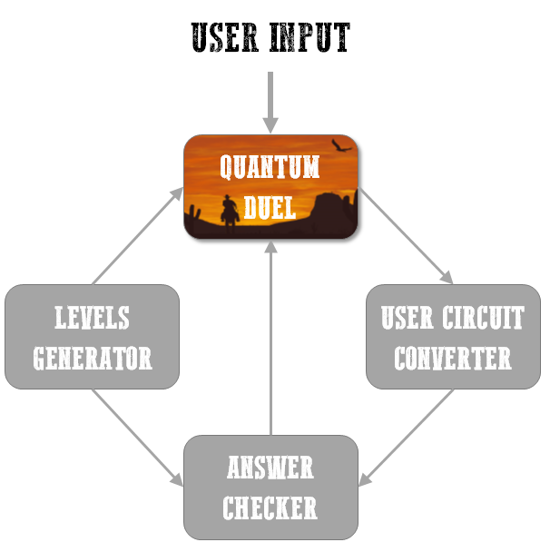
Technical details
The main computing module and the server are developed by Python with Qiskit and Tornado web server.
The front-end languages are JavaScript, CSS, and HTML.
Notes:
The main computing module and the server are developed by Python with Qiskit and Tornado web server. The fron-end languages are JavaScript, CSS and HTML. We can understand the internal structure of the game with the following diagram: we have a levels generator, which randomly select a level from a stack of levels and is sent to the server for the game to start. The server collects the user input that is passed to a converter to transform the user input to qiskit circuits. We have a checker that is constantly checking if the circuit is correct and when it is correct triggers the victory!

Slide 5
TRY IT LATER!
Notes:
If you are interested come to us later: we have the link to play live in our github repo! Try it!

